Slide 1

Info-Kiosk
Sponsor:
Bizcloud Experts
Celestial Orca
Philip Bedward Daniel Cox Matthew Dunn Aaron Liu

Slide 2
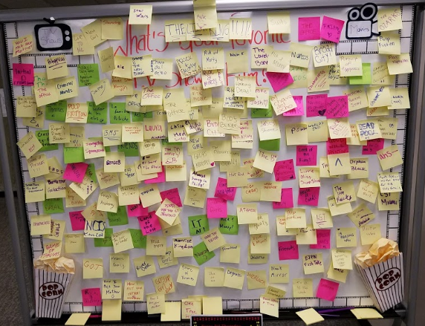
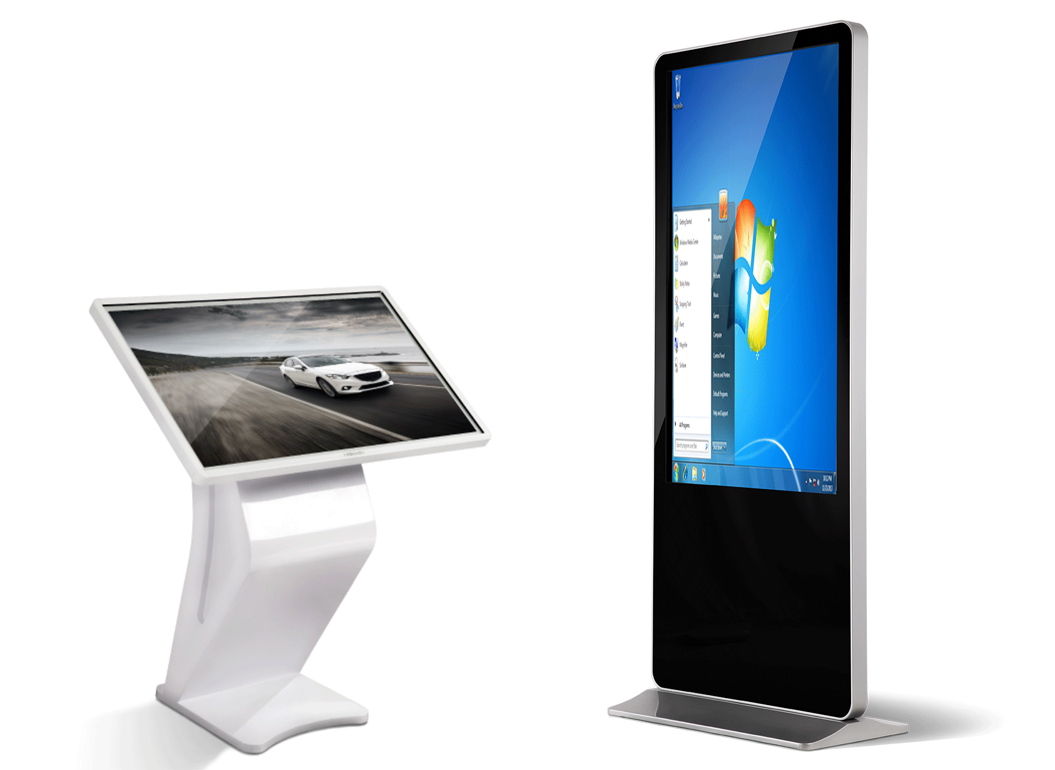
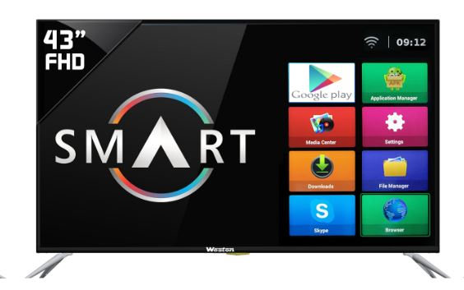
Info-Kiosk: Problem
Notes:
Description here
The problem that the sponsor faced was ...

Slide 3
Info-Kiosk: Solution
An electronic bulletin system built on top of three subsystems.
Smart TV App
displays important information to an audience
Lost and found notices
Safety alerts
Event updates
A Web App
Provides control and security around approval and dispersion of content
Allows anyone in the organization to push to the system
AWS Cloud Services
Distributed to all types of enterprises (Universities, Businesses, etc.)

Slide 4
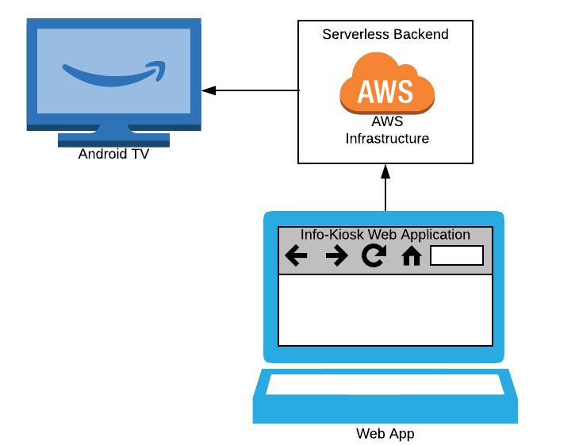


Architecture Divided into Three Sections
Web Application | Infrastructure | Smart TV Application
Behind each layer is its own separate architecture
The web application is built with the angular web framework
The Infrastructure utilizes amazon cloud services
The smart tv application operates on android tv
Built with Android SDK
High-Level Architecture
Notes:
I’ll be talking about the high level requirements and architecture of our system and how they both drive each other.
Earlier Dan threw around pieces of the architecture and spoke on how they communicated.
You all probably got an image of what the architecture looks like but for those that haven’t,
it is broken into 3 distinct sections, the web application, the infrastructure and the smart tv application.
Each of these pieces came together based on the sponsor requirements collected.
AWS Cloud infrastructure to satisfy the serverless backend
Android Tv as the IoT device to push content to
Angular Web Application that pushes the content
The specificity of the architecture will be touched on later in the slides.

Slide 5
Web App Subsystem
Built Using Angular and designed with Angular Material
User Registration via Invites
Basic authentication and features permitted only to authorized roles
List and create Content, Clients, Sections and Devices
Submit Content requests
Approve/Deny Content and Device Requests
Push Created/Approved Content to Approved Smart TV Devices

Slide 6
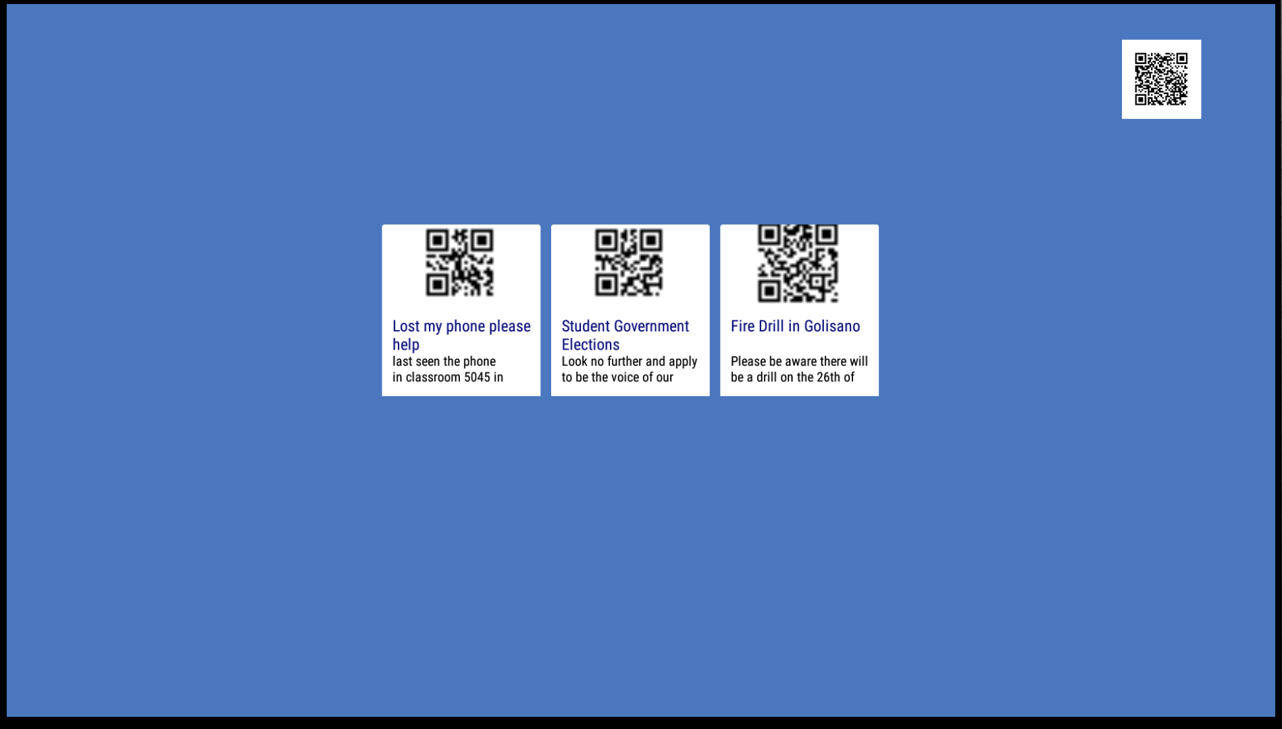
Smart TV Subsystem
Displays the approved content published by the Web Application

Slide 7
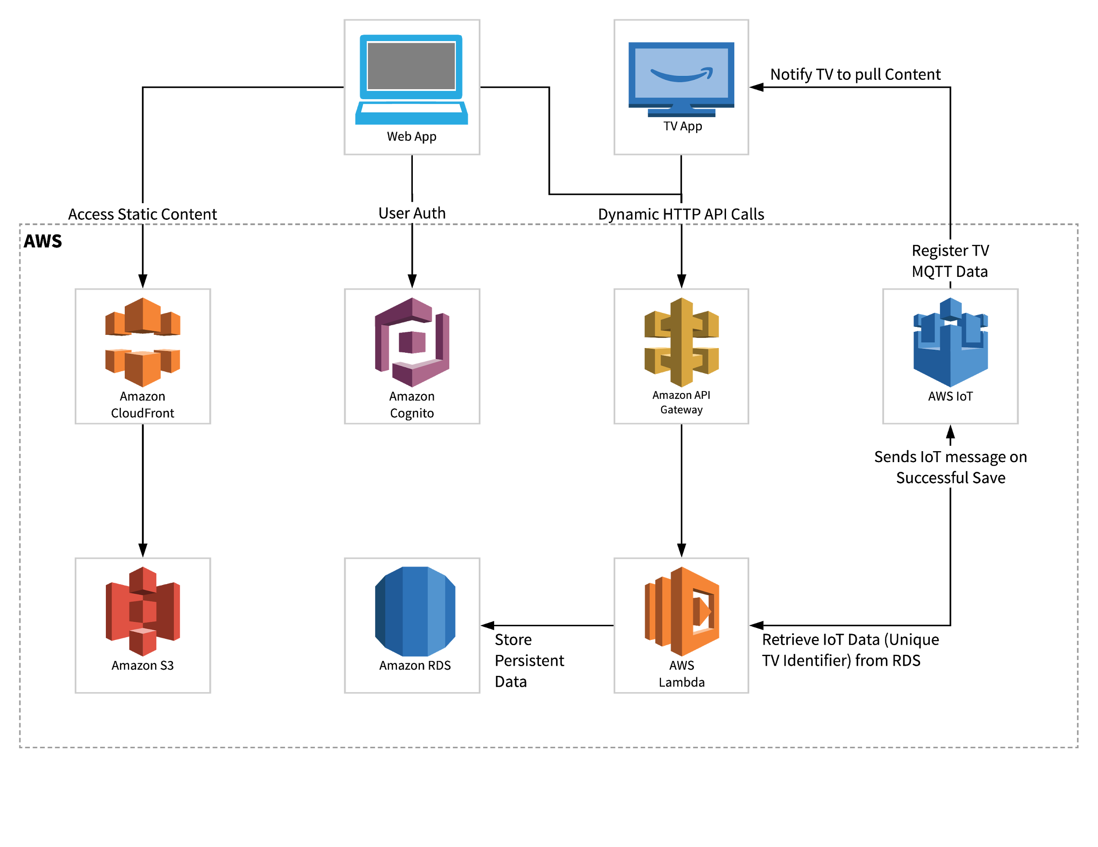
Client Approved Architecture
AWS Lambda
AWS S3
AWS IOT
AWS RDS
Android TV
Angular6
Notes:
do not need to present low-level technical design details, process methodology information, or metric data

Slide 8
How Does it Work?
Web App and Smart TV App are independent
Tied together using AWS
Sequence diagram for content request flow ?

Slide 9
Critical Design Choices
Smart TV Platform
Android TV
Web Framework
Android w/ Material
Database Technology
MySQL hosted on Amazon RDS
Security
Cognito for user authentication
Cloud Infrastructure
Amazon Web Services
Notes:
why it is the best solution for this problem and the sponsor's needs.

Slide 10
Project Plan VS Execution
Original plan got modified
Some sprint goals were moved around to better suit development as we learned what it would take to accomplish certain tasks
Missed a few deadlines
Getting development done by the agreed upon Tuesday was often difficult
Completing testing was pushed back because of this
Often the Testing for a sprint would leak in to the next sprint
Current Progress
Achieved all functionality agreed upon in project plan
Currently “tidying up,” getting ready for hand-off
Notes:
A feature is an end to end.

Slide 11
Future Plans
Edits and Deletions
List filtering / searching
Resolving latency issues
Ability to upload company logo
Uploading a picture to a Smart TV card

Slide 12
Questions

Slide 13
Project Risks
A TON of research and learning had to be done
Angular - async, overall structure, importing, etc.
Material - 100% new to us
Smart TV app development
AWS - user representation, attributes
Spring break lol
New process
New deadlines, tighter schedule
Missing deadlines causes even greater stress and risk
Notes:
Risk exposure table.
Summarize it down.
Risk table with the risks, exposure calc, indicator and mitigation.

